Slide 1
How to do Harvard Author Date Referencing Using Word

Slide 2
What is Referencing?
Referencing is the way we show where we get our information from.
It helps:
  Strengthen your arguments
  Protect copyright and prevent plagiarism
All secondary students need to do referencing in their assignments.

Slide 3
The Two Parts of Referencing are:
1. In-text citations
The part that goes into your writing.
2. Reference List (Bibliography)
This goes at the end.

Slide 4
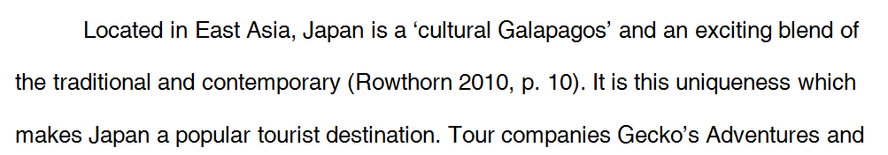
What does it look like?
This writer shows that she got the quote and these ideas …
… from the writing of this author, by using referencing.

Slide 5
What does it look like?
This type of reference is called an ‘in text citation’. It includes the author, the year and the page number.

Slide 6

What does it look like?
This style of referencing is called Harvard Author-Date, because it was invented in Harvard University (and it includes the author and the date)

Slide 7
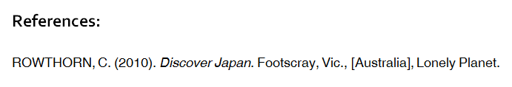
What does it look like?
A list of the documents you ‘cited’ with in-text citations is added at the end of your assignment. This is called a Reference List.

Slide 8
When do I need to use in-text citations?
You must use in-text citations when:
1. When you directly quote someone’s exact words
2. When you paraphrase someone’s ideas.
    i.e. when you take someone’s information and write it in your own words.

Slide 9
How to do Referencing
(using Word)

Slide 10
Referencing Styles
Referencing needs very specific punctuation.
Luckily, Word can do all the hard work for you.

Slide 11
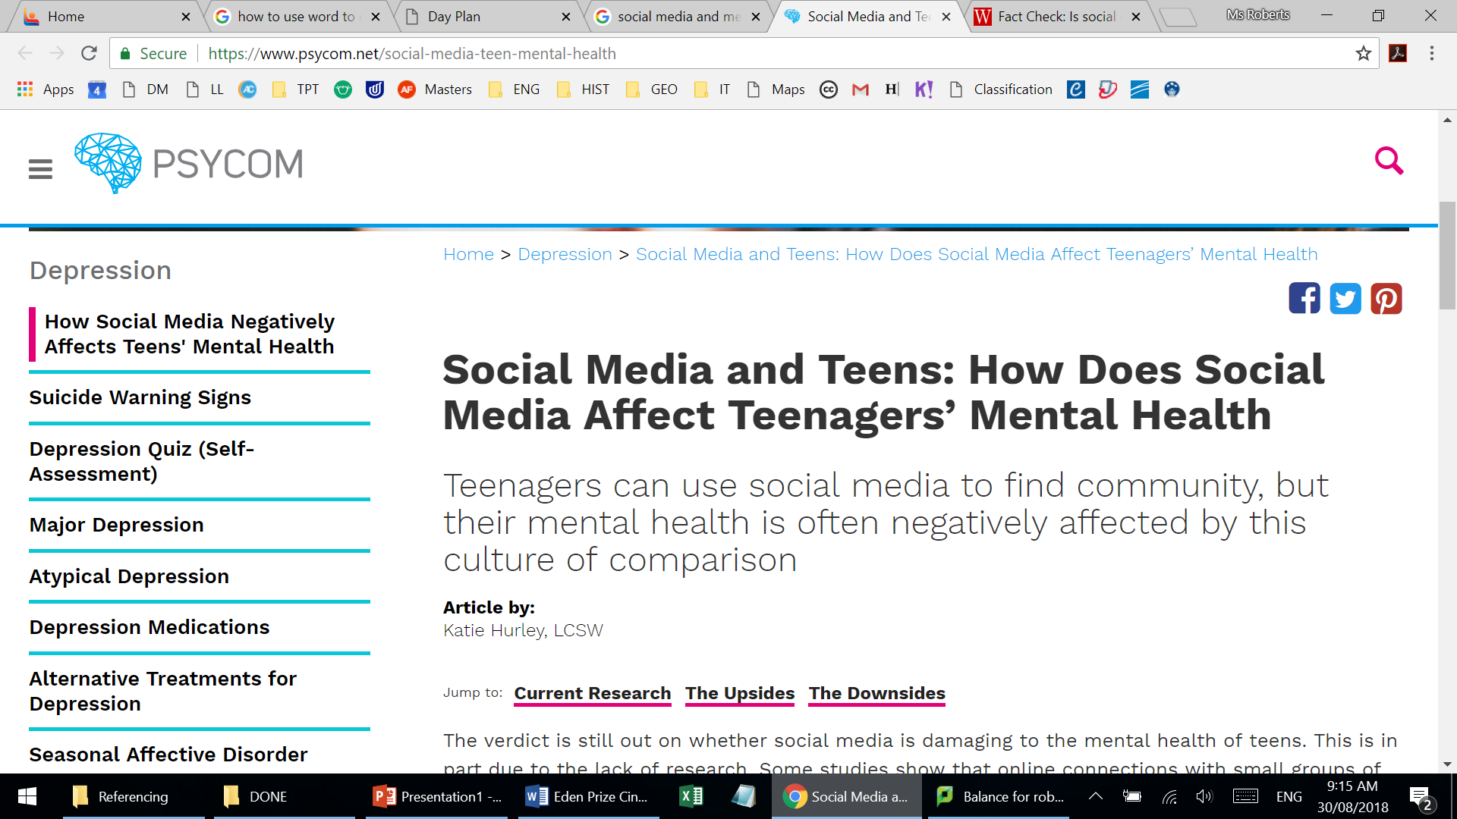
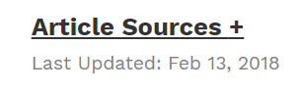
What we need:
The Website name:
The Page title:
The author:
The information I want to use:
Those who had spent more time on social media had 2.2 times the risk of reporting eating and body image concerns, compared to their peers who spent less time on social media.
The page address:
https://www.psycom.net/social-media-teen-mental-health
The date:

Slide 12
How to include in-text citations.
My assignment:
Social media addicted teens have 2.2 times the risk of ‘reporting eating and body image concerns’
Original information:
Those who had spent more time on social media had 2.2 times the risk of reporting eating and body image concerns, compared to their peers who spent less time on social media.
I wrote the information in my own words. This is called paraphrasing.
If I want to use their exact words, I put quotation marks around it. This is called ‘direct quoting’.

Slide 13
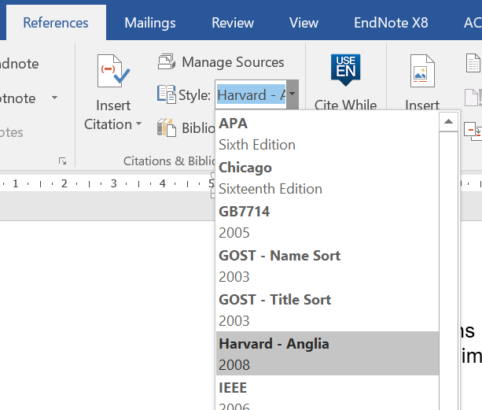
How to include in-text citations.
Go to references tab in Word.
Make sure ‘Style’ is set to ‘Harvard-Anglia’
My assignment:
Social media addicted teens have 2.2 times the risk of ‘reporting eating and body image concerns’
Original information:
Those who had spent more time on social media had 2.2 times the risk of reporting eating and body image concerns, compared to their peers who spent less time on social media.
This needs an in-text citation.

Slide 14
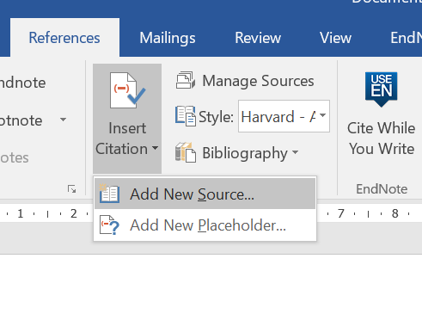
How to include in-text citations.
Choose ‘Insert Citation’
Choose ‘Add New Source’

Slide 15
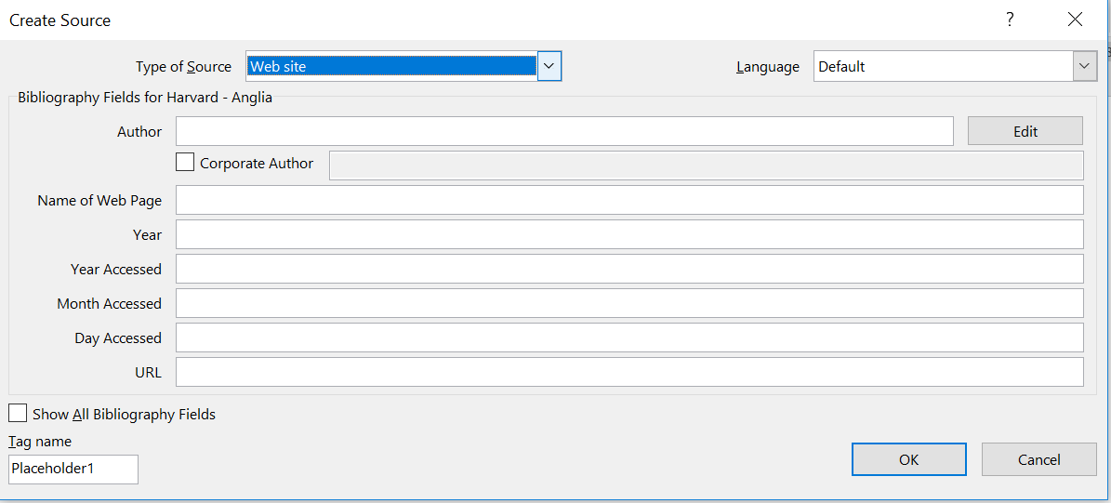
How to include in-text citations.
Fill in the information.
Change the type of source:

Slide 16
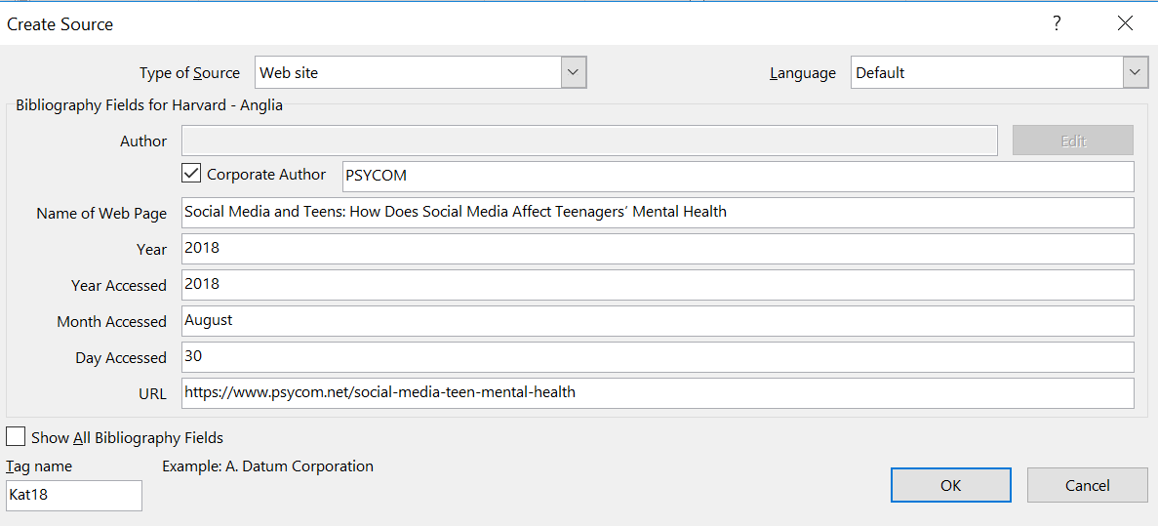
How to include in-text citations.
Fill in the information.
If you don’t know the date on which the source was published, you can put the current year.
If there isn’t an author, you can select ‘Corporate Author’ and put the name of the company or organisation instead.

Slide 17
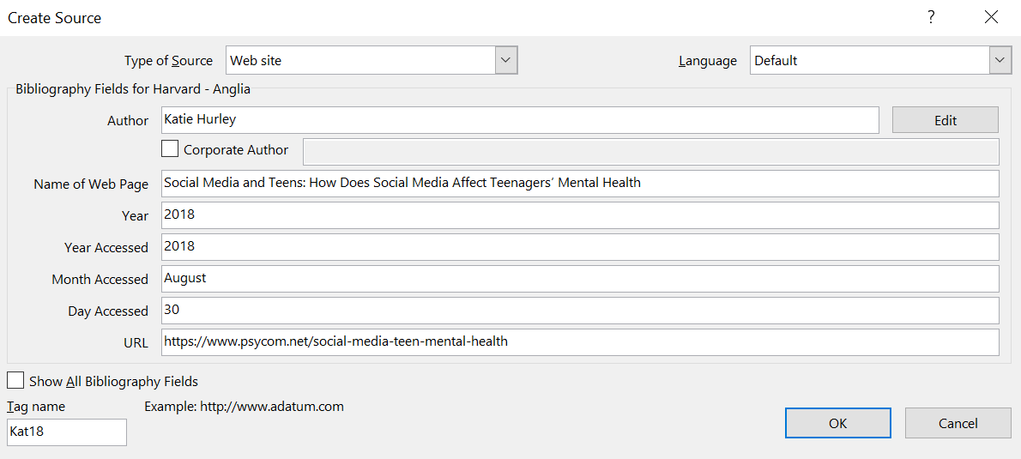
How to include in-text citations.
Fill in the information.
Put the date that you accessed the website here.
When you’re ready, click ‘Ok’.

Slide 18
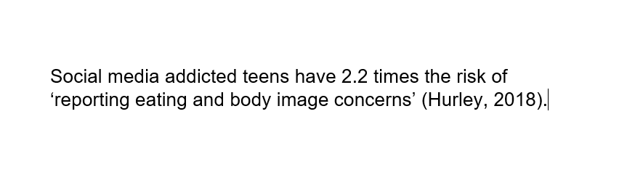
How to include in-text citations.
Word will automatically put the ‘Author and Date’ in brackets, next to the information you used.
Original information:
Those who had spent more time on social media had 2.2 times the risk of reporting eating and body image concerns, compared to their peers who spent less time on social media.
Important!
The in text citation goes INSIDE the sentence, so the full stop comes after.

Slide 19
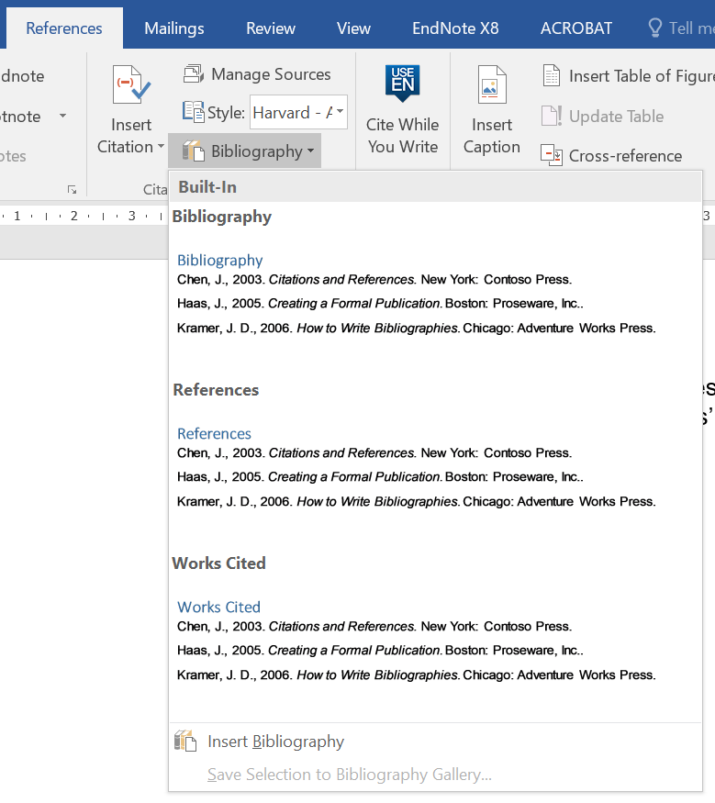
How to add a Reference List
1. Go back to the Reference Tab.
2. Choose Bibliography
Once you’ve finished your assignment, you need to add a Reference List. This is very easy to do because Word automates it.
3. Choose ‘References’

Slide 20
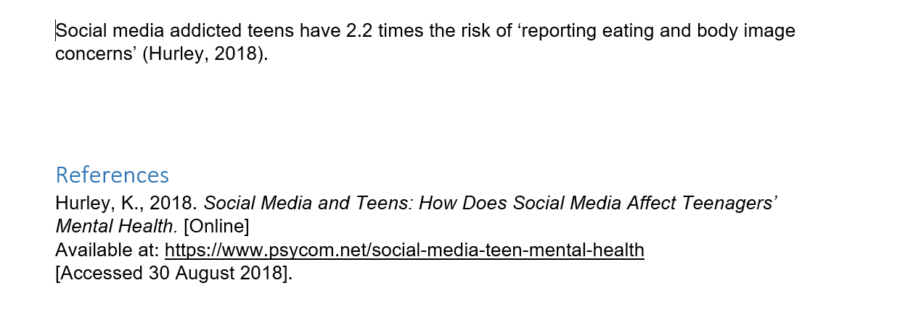
All done!
Word automatically formats and puts in the correct punctuation for your In-text Citations and Reference List.

Slide 21
Remember
All secondary students have to do referencing.
You must include an in-text citation if:
  You paraphrase someone’s ideas/knowledge
  (and it is in your own words)
  You directly quote someone
Referencing is used to:
  Strengthen your arguments
  Avoid plagiarism / copyright infringement

