Slide 1
NARRATIVE POINT OF VIEW
For Informative Text Types

Slide 2
Learning Intention
Explain what a pronoun is and how they’re used to show Narrative Point of View
Identify the three main types of Narrative POV.
Identify which type of POV is best suited for INFORMATIVE WRITING
Explain why that type of POV is best suited for Informative Writing.

Slide 3
NARRATIVE POINT OF VIEW
Is a Feature of grammar
Tells us about the relationship between the creator of the text and the audience.
Shown through pronouns.

Slide 4
Pronouns?
Ben went to the shops.
After, Ben bought a pie.
To combine these two sentences into one,
what can you do?
After Ben went to the shops, Ben bought a pie.
After Ben went to the shops, he bought a pie.
‘He’ is a pronoun.
Pronouns take the place of a noun to avoid repetition.

Slide 5
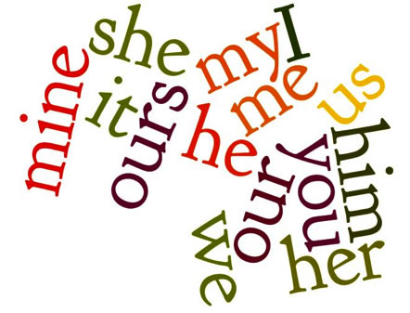
Other Pronouns?

Slide 6
Pronouns
Which pronoun you use depends on the narrative point of view
Note that pronouns are different depending on if the subject is female or male and whether there’s more of them
First Person | Second Person | Third Person
I me my mine myself we us our ours ourselves | you you your yours yourself yourselves | he she it him her its his hers | himself herself itself they them their theirs themselves

Slide 7
Plickers
Pronoun recognition

Slide 8
Types of Narrative Point of View
Three types:
First Person
Second Person
Third Person
Where have you heard ‘First Person’ or ‘Third Person’ used before?
First person shooter?
Third party insurance?
Notes:
First person shooter and third party insurance are comparatively

Slide 9


Slide 10

! …
FIRST PERSON NARRATION

Slide 11
First Person
‘I woke up this morning and went to the shops.
I can’t believe what was on special!’
Pronouns: I , me, mine, we, us, ours.
Audience Relationship:
The Narrator is the Audience.
The Narrator is speaking to him/herself.
As a creator, can you think of the advantages of writing in first person?
Disadvantages?

Slide 12
First Person
Advantages:
Reader can easily make an emotional connection with the narrator – very engaging to read
Easiest to write because it’s like how we think to ourselves
Presents belief or opinion
Useful for creative writing, blogs, editorials, reviews
Disadvantages:
Shows only the perspective of the writer.
Unavoidably biased to one perspective.

Slide 13
Narrative Points of View
FIRST PERSON
Pronouns used by the narrator:
I , me, mine, we, us, ours
Useful for:
Diary entries
Biographies
Showing the thoughts of the character
It is all from the writer’s perspective. Imagine you’re inside the head of the writer.
‘I woke up this morning and shot 20 bad guys from my window’

Slide 14

! ...
SECOND PERSON NARRATION

Slide 15
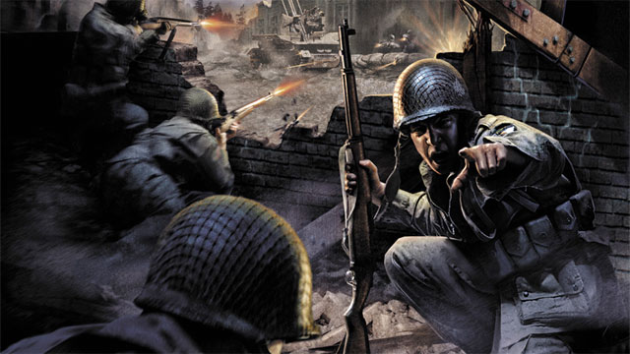

Slide 16
Second Person
‘Who’s awesome? You’re awesome!’
Pronouns: you, your
Audience Relationship:
The Narrator is speaking directly to the audience.
Sometimes the ‘you’ is dropped.
‘Go to the shops. Look for a kettle.’
In Narratives, the narrator may be partially second person: e.g. ‘Dear Reader’ or ‘Dear Diary’

Slide 17
Second Person
Advantages:
Talking directly to the audience can get their attention.
Can ‘break the fourth wall’.
Useful for: giving directions, procedure texts, make narratives more interesting, persuasive texts.
Disadvantages:
Again, bias is a problem.

Slide 18
Narrative Points of View
SECOND PERSON
Pronouns used by the narrator:
you, your
Useful for:
How-To & Procedures
Roleplaying Games
Commands
Some blogs
It’s all about YOU. Imagine the writer is speaking directly to you, the reader.
‘You! Get up! Wake up! This morning will be the greatest of your life.’

Slide 19
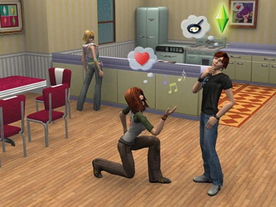

Slide 20

! ...
Hi …
Hi …
THIRD
PERSON
NARRATION

Slide 21
Third Person
‘She woke up this morning and proposed to her boyfriend.’
Pronouns: he, she, it, they, his, her, them
Audience Relationship:
The Narrator and Audience are not part of the story.
That is, the narrator is just observing what’s happening.
As a creator, can you think of the advantages of writing in third person?
Disadvantages?

Slide 22
Third Person
Advantages:
Because the narrator has no influence over what happened, third person writing is more objective. That is, less biased.
Multiple perspectives can be mentioned without one being more powerful.
Useful for informative writing, science writing, stories where multiple perspectives are needed, persuasive writing.
Disadvantages:
In story writing, third person is more distant and less emotionally engaging.

Slide 23
Science Writing
When a scientist does an experiment, they are observing the real world
Scientists have to be very careful not to be biased (being biased = bad science).
Therefore, scientists write in third person, using an objective tone.
“Two drops of solution were added to the beaker. The expected reaction was observed.”

Slide 24
Narrative Points of View
THIRD PERSON
Pronouns used by the narrator:
he, she, it, they, his, her, them
Useful for:
Information texts
Stating facts without opinion
Tell a story from the point of view of a lot of different characters
It is all from the perspective of someone looking from outside. Imagine GOD is telling the story.
‘She woke up this morning and proposed to her boyfriend.’

Slide 25
Harry Potter is a series of fantasy novels written by British author J. K. Rowling. The novels chronicle the lives of a young wizard, Harry Potter, and his friends Hermione Granger and Ron Weasley, all of whom are students at Hogwarts School of Witchcraft and Wizardry. The main story arc concerns Harry's struggle against Lord Voldemort, a dark wizard who intends to become immortal, overthrow the wizard governing body known as the Ministry of Magic and subjugate all wizards and Muggles (non-magical people).
Wikipedia

Slide 26
In literature classes in college, your professors still assign (and expect you to do) the reading, and they still quiz you on it and ask you to write papers. You write the same type of paper that you always have, but you get back a failing grade. Why? It could be because your professor is asking for a literary analysis, but you turned in a summary. In college, your professors expect you to do the reading; they don’t want basic proof that you read, remember, and can regurgitate the plot. They want something more. They want you to think critically about what happened and what the author meant when creating this work of art (the written word is a form of art!). You might be asking, “Well what is the difference between a summary and an analysis? How can I tell when I am doing one and not the other?” Well, you are about to find out!
Clelie Cottle, 2015, Motlow State Community College
https://www.mscc.edu/writingcenter/docs/resources-literary-analysis.pdf

Slide 27
He held out an enormous hand and shook Harry’s whole arm … “Call me Hagrid,” he said, “everyone does. An’ like I told yeh, I’m Keeper of Keys at Hogwarts — yeh’ll know all about Hogwarts, o’ course.”
“Er — no,” said Harry.
Hagrid looked shocked.
“Sorry,” Harry said quickly.
“Sorry?” barked Hagrid, turning to stare at the Dursleys, who shrank back into the shadows. “It’s them as should be sorry! I knew yeh weren’t gettin’ yer letters but I never thought yeh wouldn’t even know abou’ Hogwarts, fer cryin’ out loud! Did yeh never wonder where yer parents learned it all?”
“All what?” asked Harry.
“ALL WHAT?” Hagrid thundered. “Now wait jus’ one second!”
He had leapt to his feet. In his anger he seemed to fill the whole hut. The Dursleys were cowering against the wall. …
“You never told him? Never told him what was in the letter Dumbledore left fer him? I was there! I saw Dumbledore leave it, Dursley! An’ you’ve kept it from him all these years?”
“Kept what from me?” said Harry eagerly.
“Ah, go boil yer heads, both of yeh,” said Hagrid. “Harry — yer a wizard.”
Harry Potter and the Philosopher’s Stone by J.K. Rowling

Slide 28
One of my first jobs was at a bookstore. When I was a kid my Mom would take me to the mall and I would spend tons of time hanging out at Waldenbooks (who here remembers Waldenbooks?) Right when I became legally old enough to work, I went in and submitted my application and a few weeks later I was selling literature to the masses.
Towards the end of my tenure at Waldenbooks - as Oprah's book club was hitting its stride and Men Are From Mars, Women Are From Venus was in its bazzilionth week on the New York Times best seller list - a book display arrived featuring a buzzy new title about a certain boy wizard. I remember the display at the front of the store, and selling a few copies, but I didn't realize what it would become.
A few years later (early 2000s), I had kinda gotten out of the loop on what was big in books. I had just finished college, which had taken up most of my free reading time. A friend of mine named Bronco (yup, real name, not a nickname, who also was the Best Man at my wedding) had a copy of this book on his coffee table. Holy cow! Here is that same book we were selling at Waldenbooks about 5 years before - what was he doing with it!?
Well, he said it was good, so I borrowed it. I quickly plowed through the first 4 books and then got the pleasure of joining the world in waiting for the release of Order of the Phoenix. And, I noticed when I went to the bookstore, the YA section and selection was not so small anymore. I truly believe it was Harry Potter that opened the door to get more young adults (and even adults, of course) reading and authors interested in writing for that genre.
Mathew, Goodreads Review

Slide 29
Learning Intention
Explain what a pronoun is and how they’re used to show Narrative Point of View
Identify the three main types of Narrative POV. first, second, third
Identify which type of POV is best suited for INFORMATIVE WRITING third
Explain why that type of POV is best suited for Informative Writing. because it allows the narrator to take themselves out of the writing / that is, be objective and unbiased

