Slide 1
Subjective Language = Connotative
“I know what you said, but what did you mean?”

Slide 2
Connotation vs denotation
Basically:
DENOTATION: the precise, literal meaning of a word.
CONNOTATION: the positive and negative associations of a word.

Slide 3
SYNONYM vs ANTONYM
SYNONYM = same meaning.
sun = with
onoma = name
ANTONYM = opposite meaning.
anti = opposite
onoma = name

Slide 4
Connotation vs denotation
Remember the difference:
DENOTATION is D for dictionary.
Words can have multiple denotations:
https://www.youtube.com/watch?v=XZ3LE5hD96A

Slide 5
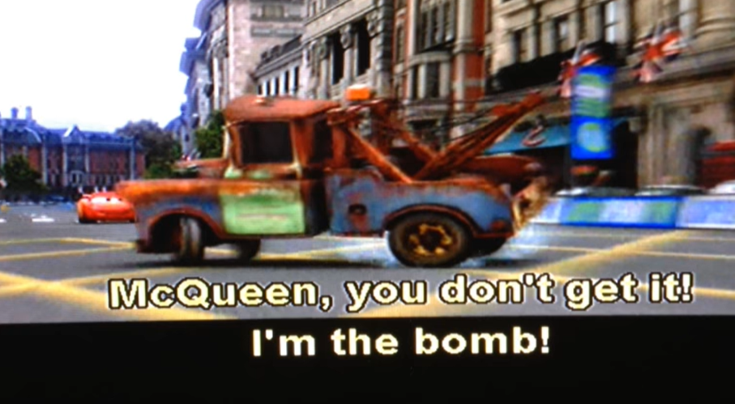
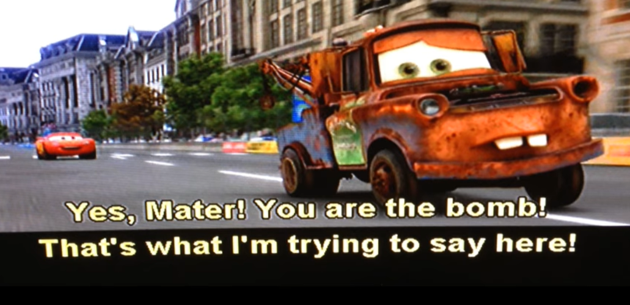
DENOTATION and CONNOTATION depend on context
Context = where and when a text is used.
I’m the best! 
You’re going to blow up! 

Slide 6
For example:
Thin, slim, lanky, skinny, gaunt, slender
All of these words basically mean the same thing (that is, they have the same denotation)
However, they have different connotations.
Which of these words has positive associations?
Which of these has negative?
Which are neutral?
Notes:
Adapted from: https://www.csun.edu/~bashforth/098_PDF/06Sep15Connotation_Denotation.pdf

Slide 7
For example:
Thin, slim, lanky, skinny, gaunt, slender
All of these words basically mean the same thing (that is, they have the same denotation)
However, they have different connotations.
Which of these words has positive associations?
Which of these has negative?
Which are neutral?

Slide 8
Rank from Positive ☺ to NEGATIVE ☹
Aggressive, assertive, domineering, dynamic, pushy, forceful
Shrewd, egghead, bright, clever, brilliant, cunning, smart, intelligent, brainy

Slide 9
CONNOTATION
Connotation depends on culture, experiences etc.
They change over time, depending on what’s going on.
asylum seeker
refugee
illegal immigrant
boat person

Slide 10
Some words which have changed connotation over the 20th century:
diversity, team player, right wing, follower, gay, minority, feminist, left wing, abuse, conservative, motherhood, extremist, harassment, propaganda, peacekeeper, and comrade.

Slide 11
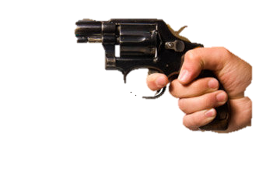
Words with a strong emotional connotation are POWERFUL
They are more persuasive, show the author’s opinion and grab attention.
Words with strong connotations are sometimes called loaded.

Slide 12
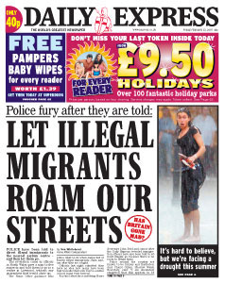
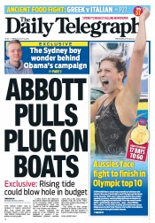
Connotation Has Impact On Changing Minds:

Slide 13
Which leaves you with a positive viewpoint regarding homeless people?
Each of these phrases has the same denotation, but vary in connotation.
There are over 2,000 vagrants in the city.
There are over 2,000 people with no fixed address in the city.
There are over 2,000 homeless in the city

Slide 14
TO BE OBJECTIVE …
… you need to aim for words with a neutral connotation.

Slide 15
Looking for Objective News
https://theconversation.com/au is written by university lecturers and is generally written in objective language.
Most news stories by the ABC are written objectively, but they have been accused of bias towards the left.
Be wary of commercial news outlets, especially NewsCorp (Advertiser, Fox, News.com.au) and Fairfax (The Age, SMH)
See bias checks of individual news bodies here: https://www.allsides.com/media-bias/media-bias-ratings or https://mediabiasfactcheck.com/
These are the news sites which are rated as ‘centre’ or ‘least biased’:
https://mediabiasfactcheck.com/center/

Slide 16
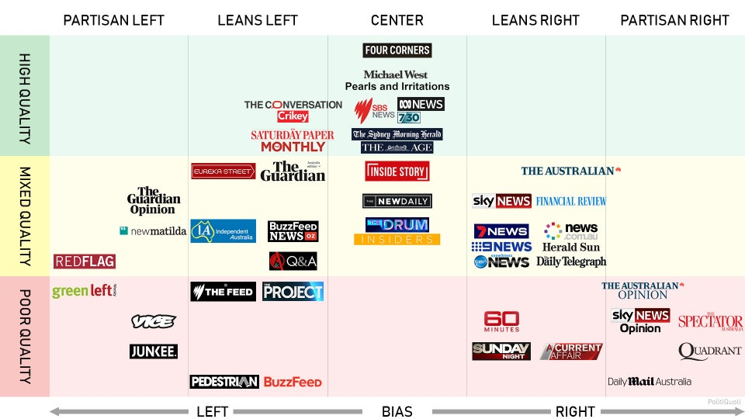
NEWS SOURCES IN AUSTRALIA
“Center” = More Objective, less Bias
Obviously, aim for Higher quality over poor.

